Slide 1
Can ResNet-50 hugging face model, with chest X-rays, achieve state-of-the-art performance in detecting COVID-19 pneumonia from chest X-rays, while requiring fewer training resources compared to other models?
Makhmutov Iliaz 21229553

Slide 2

What is Hugging Face and why is it important?
Hugging Face is platform for AI community, providing cool tools that allow work with pre-trained Artificial Language models.

Slide 3
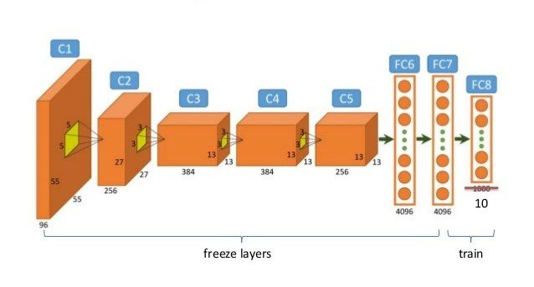
How can pretrained models accelerate data science and AI research?
Pretrained models already have some basic background that helps them analyze new data in a faster way by adding some correctness to it.

Slide 4
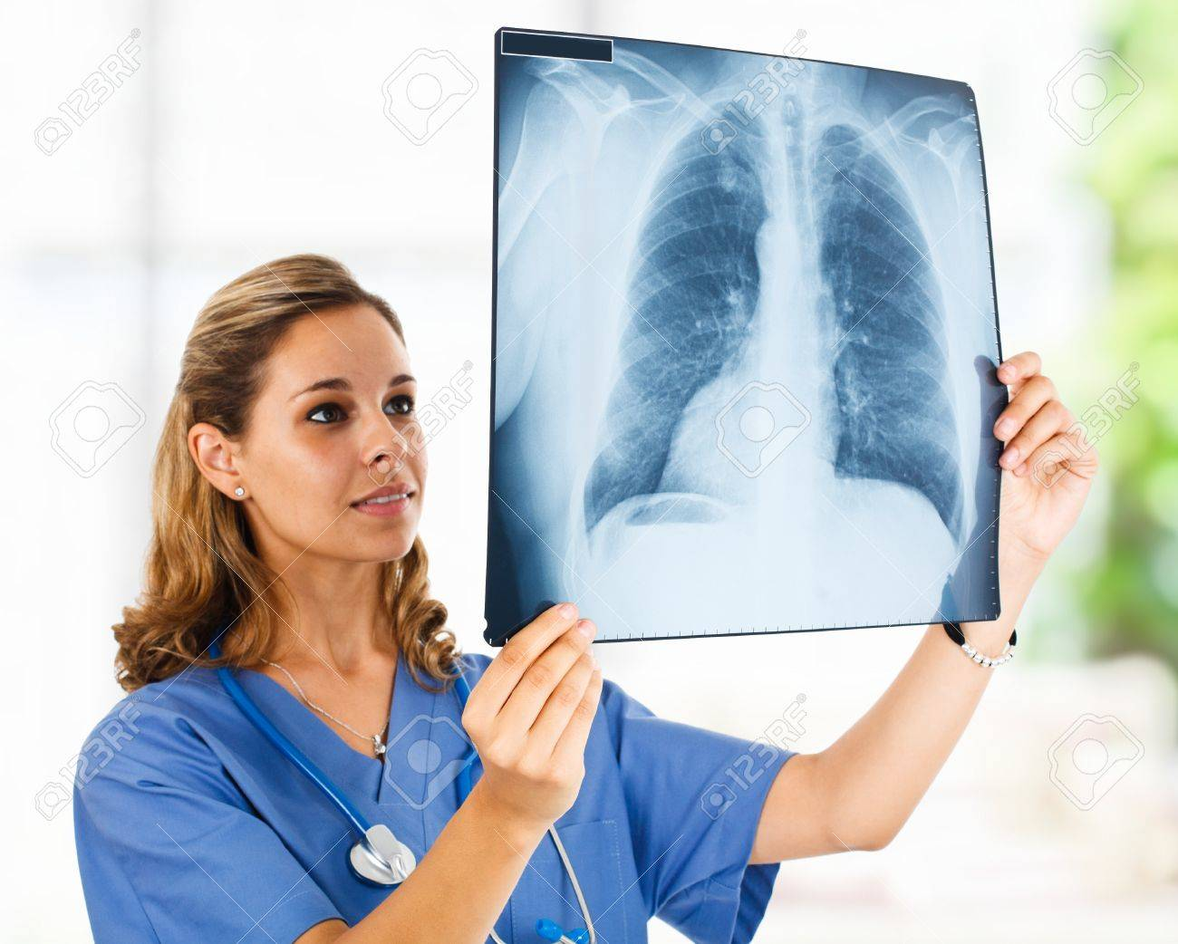
What problem are you addressing with Hugging Face pretrained models?
Can ResNet-50 v1.5, fine-tuned with chest X-rays, achieve state-of-the-art performance in detecting COVID-19 pneumonia from chest X-rays, while requiring fewer training resources compared to other deep learning models?

Slide 5
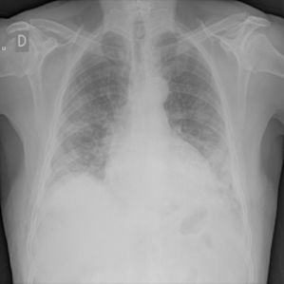
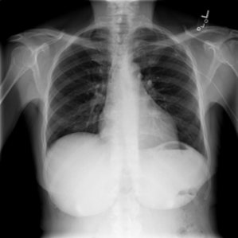
Why is this problem important to data science and AI?
If COVID (or the same illness) were to start harming the lungs, it would be much faster and cheaper to detect it by using a program that analyzes X-rays.
If we can detect COVID faster that mean that we can start treatment process
COVID
Normal

Slide 6
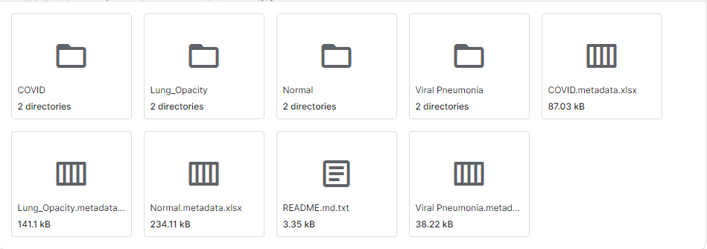
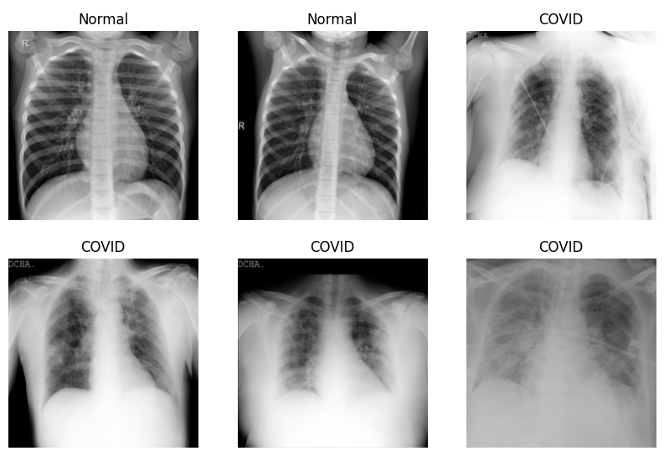
Data and Preprocessing
I used the COVID-19 Radiography Database from Kaggle, which contains different folders.
In my data folder, I retained only two types, COVID and Normal, and reduced the number of images from 8000 to 2200

Slide 7
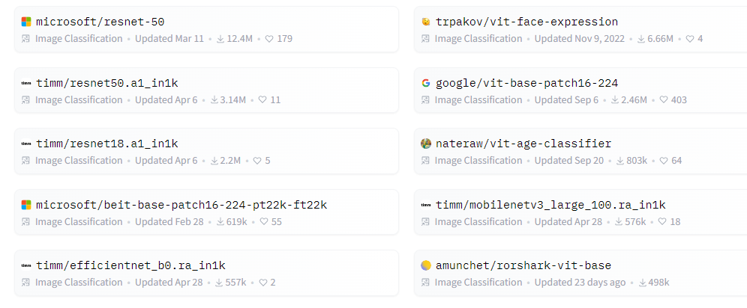
Model
I used the Microsoft/ResNet model because it is the most downloaded model on Hugging Face.

Slide 8
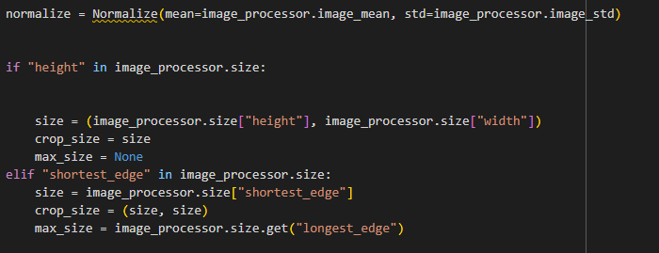
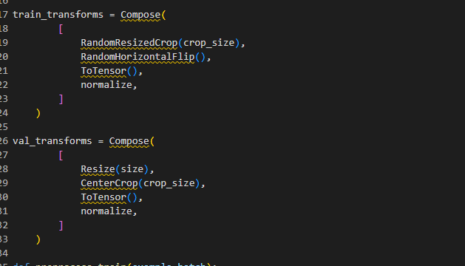
Normalize images

Slide 9
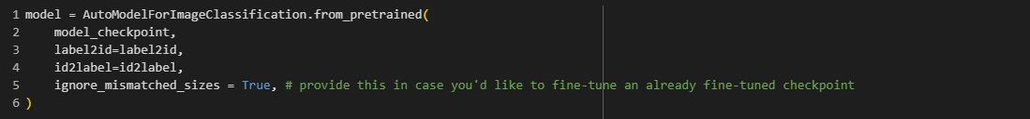
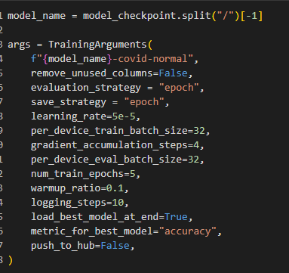
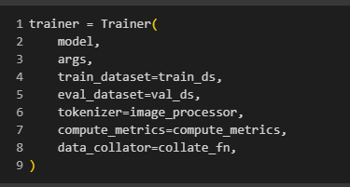
Installing optimize, and train pre trained model

Slide 10
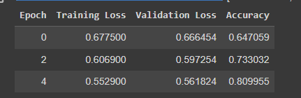
Testing accuracy

Slide 11
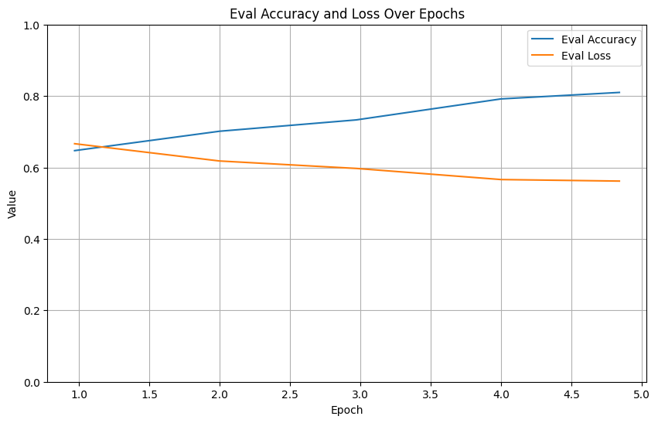
Accuracy and evaluation loss by epoch

Slide 12
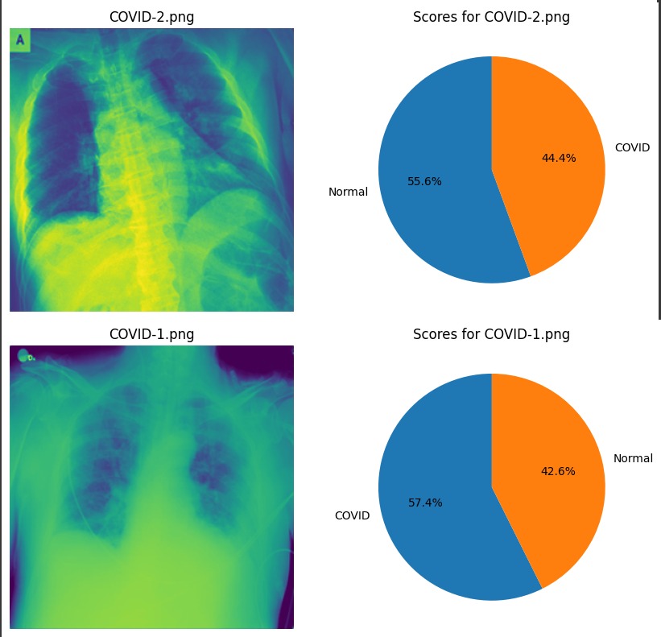
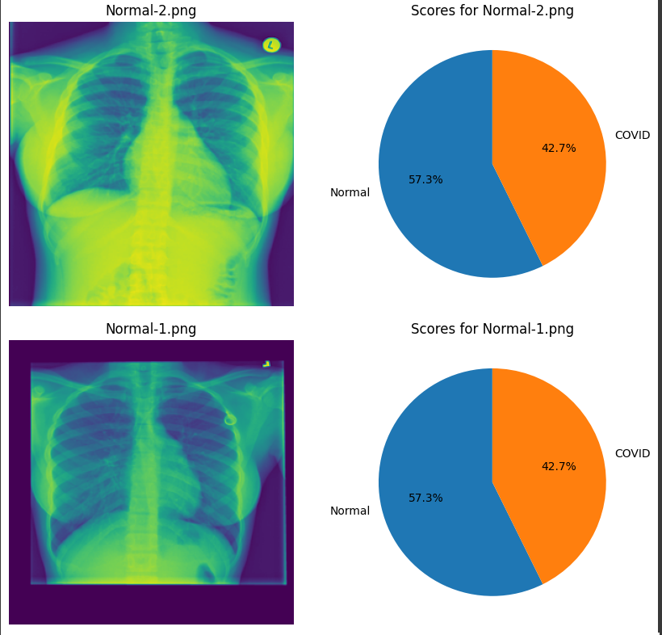
Test

Slide 13
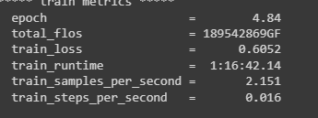
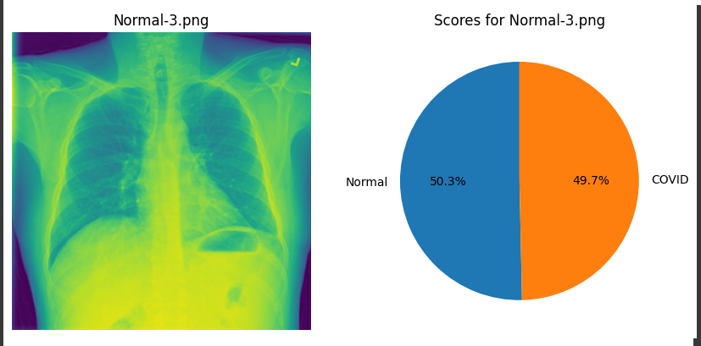
Conclusion on the training of the Hugging Face pre-trained model.
It took more than 1 hour to train it on Colab with 2200 images
Training accuracy is equal 80%
Sometimes show close values

Slide 14
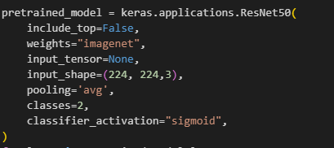

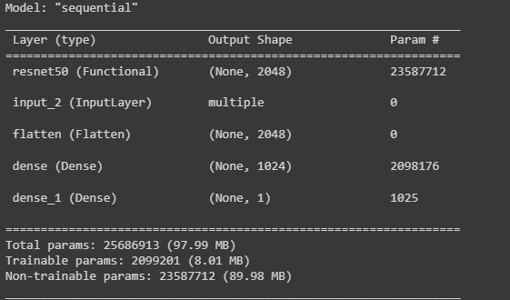
Other pre-trained model
Import and use the ResNet50 model from the 'Kernel.application' as a layer in my custom model.

Slide 15
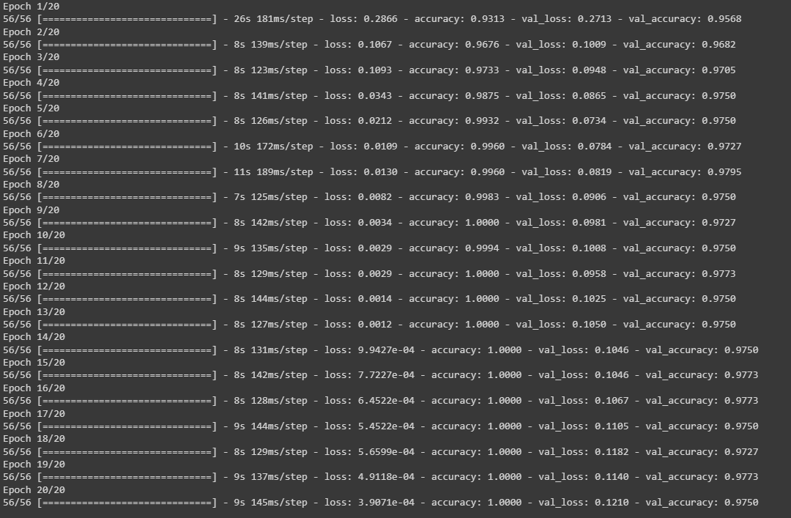
It took less than 7 minute to train model with 20 epoches

Slide 16
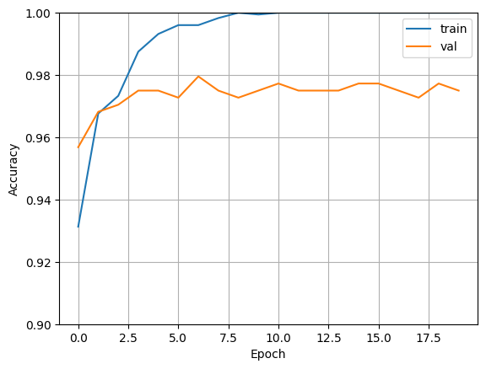
Hugging face model
Kernel model

Slide 17
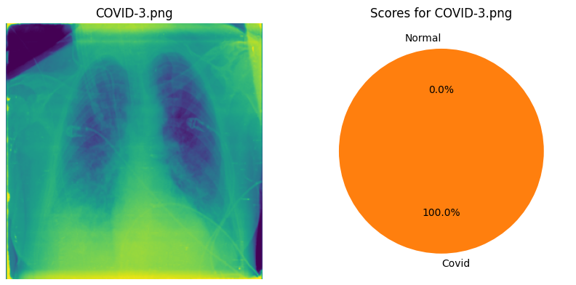
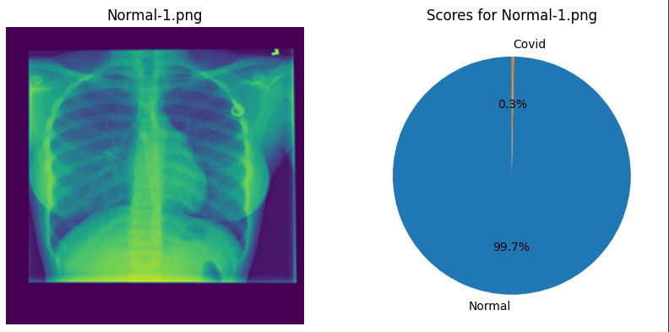
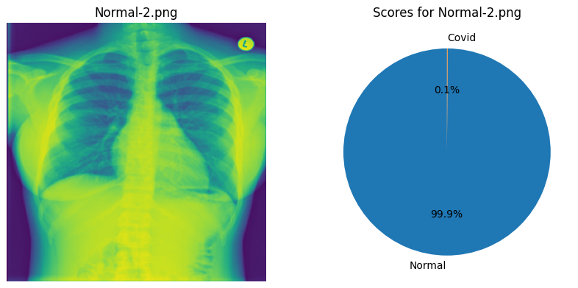
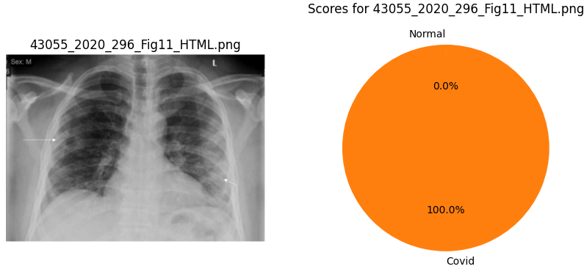
Predictions by Kernel model

Slide 18
Conclusion
In some cases, the Hugging Face ResNet model may require more resources and exhibit lower accuracy compared to the same model from the Kernel

Slide 19
References
Huggingface. (n.d.). Fine-tuning for Image Classification with 🤗 Transformers. GitHub. https://github.com/huggingface/notebooks/blob/main/examples/image_classification_albumentations.ipynb
Rahman, T. (2022, March 19). Covid-19 radiography database. Kaggle. https://www.kaggle.com/datasets/tawsifurrahman/covid19-radiography-database
tensorflow. (n.d.). Tf.keras.applications.resnet50.ResNet50 : tensorflow V2.14.0. TensorFlow. https://www.tensorflow.org/api_docs/python/tf/keras/applications/resnet50/ResNet50
YouTube. (2021, June 29). Transfer learning using keras(resnet-50)| Complete python tutorial|. YouTube. https://www.youtube.com/watch?v=JcU72smpLJk&ab_channel=NachiketaHebbar

